Slide 1
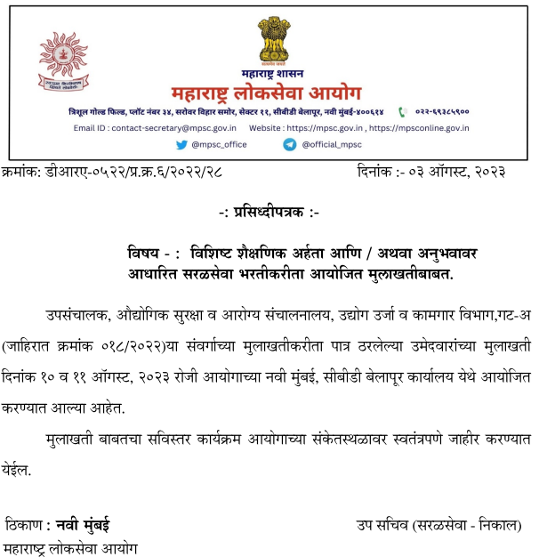

Slide 2
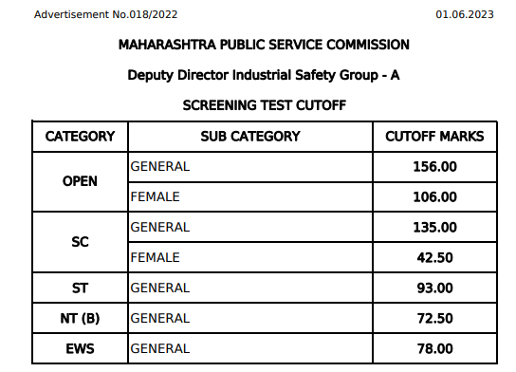
Candidates Selected for Interview 45 for 9 Posts

Slide 3
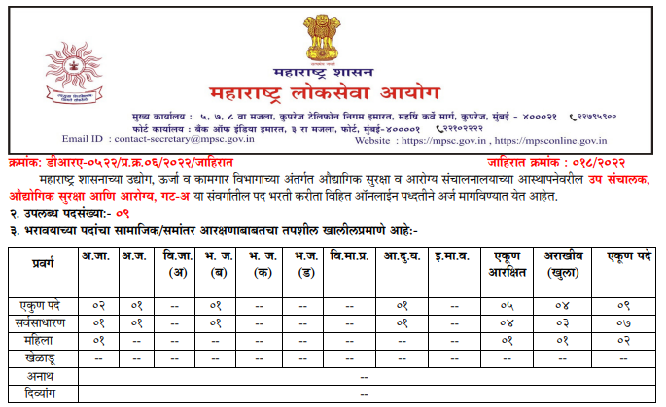
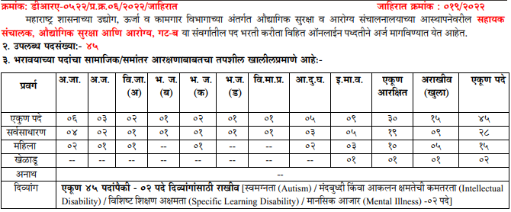

Slide 4
Expected Ranks & Marks
Rank category 2023 expected Merit
1st OG (1) 50 + 156 = 206
3 rd OG (3) 30 + 156 = 186
4 th SC (1) 50 + 135 = 185
5 th Open F (1) 50 + 106 = 156
6 th ST (1) 50 + 93 = 143
7 th EWS (1) 50 + 78 = 128
8 th NT B (1) 50 + 73 = 123
9 th SC F (1) 50 + 43 = 93

Slide 5
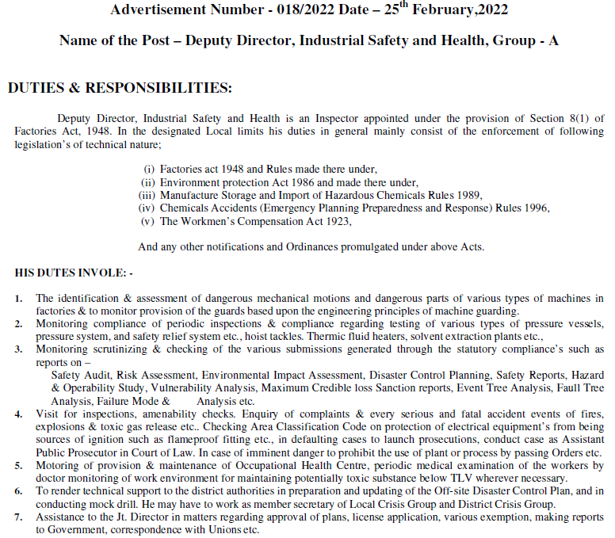

Slide 6
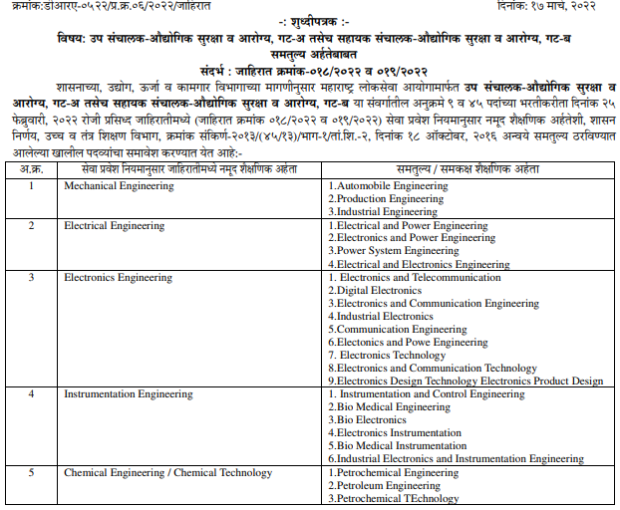

Slide 7
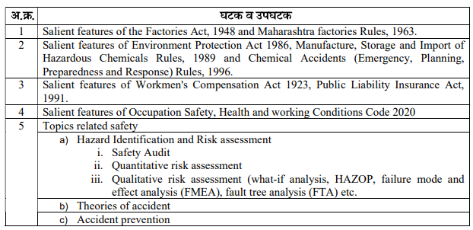
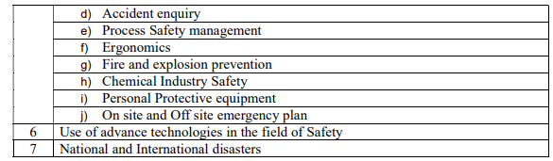

Slide 8
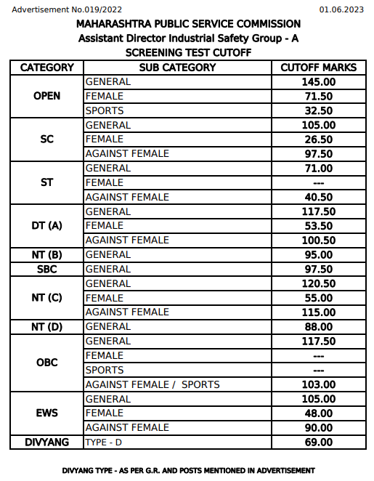
Candidates Selected for Interview 229 for 45 Posts

Slide 9
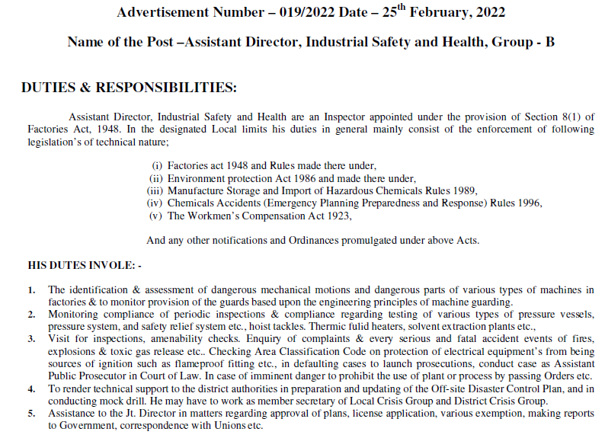

Slide 10
Knowledge wrt Duties of ddISH
Salient features of various acts and procedures
National and International disasters
Dangerous Machine parts and mechanical motions
Accidents
Use of advance technologies in the field of Safety
Hazard Identification and Risk assessment

Slide 11
Salient features of various acts & procedures –
ddIHS as Assistant Public Prosecutor
ddIHS as member secretary of Local Crisis Group and District Crisis Group
ddIHS as assistance to the Jt. Director
Enforcement of legislations
dealing with Defaulting cases
passing Orders for closure

Slide 12
National and International disasters
Disaster Control Planning
On site and Off site emergency plan
Mock drills
Fire and explosion prevention
SOP wrt toxic gas release
Maximum Credible loss Scenario

Slide 13
Dangerous Machine parts and mechanical motions
Pressure vessels, pressure system, hoist tackles,
Thermic fluid heaters, solvent extraction plants
Principles of machine guarding
Personal Protective equipment
Ergonomics
Protection of electrical equipment’s from being sources of ignition - flameproof fitting

Slide 14
Accidents
Theories of accident
Accident prevention
Protection of electrical equipment’s from being sources of ignition - flameproof fitting
Maintaining potentially toxic substance below TLV
Area Classification Code
Accident enquiry
Occupational Health Centre
Periodic medical examination of the workers by doctor
Environmental Impact Assessment

Slide 15
Use of advance technologies in the field of Safety
Safety relief system
Process Safety management
Safety Audit
Safety Reports
Chemical Industry Safety

Slide 16
Hazard Identification and Risk assessment
Hazard & Operability Study - HAZOP
Vulnerability Analysis
Quantitative risk assessment
Qualitative risk assessment
What-if analysis
Event Tree Analysis
FMEA (failure mode and effect analysis)
FTA (fault tree analysis)

Slide 17
MPSC Interview for AMC
One has to set a target to achieve a good score in Interview so that you can get a desired rank or post.
With Optimum preparation it is possible to achieve a good score.
One has to understand the objectives of Interview and accordingly try to inculcate those qualities in his or her personality.

Slide 18
The object of the Interview is to assess the personal suitability of the candidate for a career in public service by expert group of competent and unbiased panel members.
It is intended to judge the mental caliber of a candidate.
It is an assessment of not only his/her intellectual qualities but also social traits and his/her interest in current affairs.
Some of the qualities to be judged are - mental alertness, critical power of assimilation, clear and logical exposition, balance of judgment, variety and depth of interest, ability for social cohesion and leadership, intellectual and moral integrity.
Questions will be asked on matters of general interest. Interview is intended to be a test of both the specialised or general knowledge of the candidates.
The technique of the Interview is that of a natural, directed and purposive assessment, intended to reveal the mental qualities of the candidate.

Slide 19
MPSC tries to assess personality of the candidate by asking general questions, intended to test the various traits….
Personal suitability of the candidate for a career in public service
Critical power of assimilation
Clear and logical exposition
Balance of judgment
Variety and depth of interest
Ability for social cohesion and leadership
Intellectual and moral integrity
Assessment of specialised or general knowledge
Interest in current events
Mental alertness - mental caliber

Slide 20
Personality Traits
Personal Suitability….. TK, BC, MS
Critical power of assimilation
Clear and logical exposition
Depth & Variety of interest
Balance of judgement
Intellectual & Moral integrity
Social cohesion & Leadership
Communication skills
Mental alertness
ATMA

Slide 21
Assessment of specialised or general knowledge of the candidate -
Questions are designed in such a manner, that they will test Candidate's optimism in Specialised or General Knowledge related to following qualities -
intellectual qualities (IQ)
social traits (SQ)
thought process (TQ)
emotional stability (EQ)
Here optimum knowledge means the information sufficient & essential to solve a particular Q.

Slide 22
PSC
Personal Suitability of candidate -
TK
MS
BC
Bureaucrat is expected to find solution to the problems which he/she faces during his/her career at various levels. For that matter he/she, needs to be master of none, but jack of all trades.
He/she should know at least something about everything & not necessarily everything about something.
So he/she needs to acquire certain productive skills of rationalised analysis.

Slide 23
CPA
Critical Power Of Assimilation
Why
What
How
Assimilation is an ability to understand things fully or completely. If candidate is mentally alert, he will be better placed to assimilate the questions asked and then generate an honest and thoughtful response/answer.
One has to learn to understand why the question has been asked, and also what panel members are expecting from him.
This personality trait is a means for sensitization towards the society. To display this trait, one should first listen the question carefully.
If you incorrectly comprehend a question, chances are more that you wouldn't be able to satisfy the pannel members. Never ever try to answer before understanding the question.

Slide 24
CLE
Clear & Logical Exposition
Clarity
Rationalism
Intuition
Clear exposition or description of certain thought or an idea, requires a clear understanding of not only the demand of question, but also a character that is honest and simple. Only honesty can bring out clear and logical answer.
While answering it is very important to be straight to the point. Beating around the bush exhibits your superficial knowledge.
One should clearly answer only if he/she knows the demand of the question.
It is duty of candidate, let the panel know that he/she is most suitable candidate.
It should be done in organised manner a with a great discipline.
One should do it humbly but assertively, in a simple manner but confidently and honestly.

Slide 25
DVI
Depth & Variety of Interest
Concepts
Application
Updation
Answer should have depth of an understanding of various issues, especially current events.
Candidates are expected to have taken an intelligent interest not only in their special subjects of academic study but also in the events which are happening around them both within and outside their own state or country as well as in modern currents of thought and in new discoveries which should rouse the curiosity of well educated youth.

Slide 26
BoJ
Balance of Judgment
Extent
Depth
Intention
In Interview, ability to analyze many issues without bias is always checked.
While answering one should try to link various issues and analyze them critically. A biased view always reflects shallowness.
Lot of confidence comes from an understanding the demand of the question.

Slide 27
SII
Social & Intellectual Integrity
Integrity
Ethics
Probity
Every answer given by candidate carries an hint about these traits.
Integrity is so crucial that whole process of preparation depends on it.

Slide 28
SCL
Social Cohesion & Leadership
Leadership
Motivation
Empathy
Candidates answers must reflect his/her concern wrt issues raised during Interview.
This concern will be reflected only if the answer is derived from own experience instead of reproducing facts from the books.

Slide 29
BL
Body Language
Posture
Facial expressions
Eye contact
Body movement

Slide 30
Body language
  Posture
    Stability, first impression, capacity to handle the situation, ability to instill the trust
  Facial Expressions
    Stress, confusion, ignorance, Indicator of thought process
  Eye contact
    Confidence, humility, obedience, convincing capability
  Body movement
    Excitement, lack of suitable words, aggression

Slide 31
CS
Communication Skills
Medium
Content
Succinct
Presence of MPT
Ability to C (4Cs)

Slide 32
Source of Qs (BK)
Profile
Academics
Job experience
Extra curricular, Hobbies
Current affairs
Knowledge of department/ Post/cadre
Service Record/Exposure
Family & district

Slide 33
The Nature and standard of questions in the Interview will be such that a well-educated person will be able to answer without any specialised study and its intention is to test candidate’s general awareness of a variety of the subjects.
It is expected from the candidate to study the latest and recent developments and happenings pertaining to the said cadre/post.

Slide 34
Personality / ATMA
  Awareness
  Alertness
  Attitude / Appearance
  Aptitude
  Thought
  Mentality
  Approach
  Action
  Aspiration
  Agility
  MPSC selects an officer after judging mental caliber of the candidate.
  The questions asked at all levels are designed to find out alertness, awareness, attitude & aptitude of the candidate. Here alertness is intrinsic, awareness is extrinsic.
  One should remember attitude is related to candidate's willingness to undergo training successfully and effectively.
  Aptitude is a Capacity of candidate to perform a given task to achieve a specific target in given time frame, with available resources.

